Slide 1


INVESTIGATION OF WELD TEST USING
COLD METALTRANSFER ON
AUSTENITIC STEEL
By
Project Members
DHANUSH D - 211419114070
RANJITH KUMAR K N - 211419114369
RAPURI TEJA - 211419114370
VIJAY SINGH MK - 211419114389
Batch No : 28
Under the Supervision
Of
Mr. D. NITHYANAND M.E., (Ph.D).
Assistant Professor,
Department of Mechanical Engineering,
Panimalar Engineering College.

Slide 2
ABSTRACT
Joining of similar metals has found its use extensively in power generation, electronic, nuclear reactors, petrochemical and chemical industries due to environmental concerns, energy saving, high performance, cost saving. However efficient welding of similar metals has posed a major challenge due to difference in mechanical of the materials to be joined under a common welding condition.
This causes a steep gradient of the mechanical properties along the weld. A variety of problems come up in similar welding like cracking, large weld residual stresses, migration of atoms during welding causing stress concentration on one side of the weld, compressive and tensile stresses, stress corrosion cracking, etc. To overcome this causes there are required to study the effect of welding process parameter on mechanical property.

Slide 3
The aim of this research is to investigate the tensile strength properties of similar metal welding of SS304 using Cold Metal Transfer (CMT) process with SS316L as a filler material by optimizing the welding parameter.
The experimental results were obtained corresponding to the effect of different welding current, different welding speed and different gas pressure on ultimate tensile strength and impact strength of butt joint.

Slide 4
LITERATURE SURVEY
"Effect of welding parameters on microstructure and mechanical properties of SS304 austenitic stainless steel joints by Cold Metal Transfer (CMT) welding" by S. N. Das and colleagues (2016) focuses on the effect of welding parameters on the microstructure and mechanical properties of SS304 steel joints welded using the CMT process. The study found that the heat input, wire feed rate, and travel speed had a significant impact on the weld's microstructure and mechanical properties. The authors concluded that the CMT process produced high-quality welds with good mechanical properties when appropriate welding parameters were used. This study provides valuable information for anyone looking to optimize the CMT process for welding SS304 steel.

Slide 5
"Investigation of cold metal transfer (CMT) welding process for joining austenitic stainless steel" by A. H. Ahsan and colleagues (2021) explores the feasibility of the CMT process for joining austenitic stainless steel. The authors conducted a series of experiments to evaluate the mechanical properties of SS304 steel joints welded using the CMT process. The study found that the CMT process produced welds with excellent mechanical properties, including high strength and ductility. The authors concluded that the CMT process has the potential to replace traditional welding processes for joining austenitic stainless steel. This study highlights the potential of the CMT process as a viable alternative to traditional welding methods.

Slide 6
COLD METAL TRANSFER WELDING (CMT)
CMT is a subset of gas metal arc welding. It works by reducing the weld current and retracting the weld wire when detecting a short circuit, resulting in a drop- by-drop deposit of weld material.
Cold Metal Transfer (CMT) is a welding method that is usually performed by a welding robot. The CMT machine detects a short circuit which sends a signal that retracts the welding filler material, giving the weld time to cool before each drop is placed. This leaves a smooth weld that is stronger than that of a hotter weld. This works well on thin metal that is prone to warping and the weld burning through the material.
Welding wire is fed through the system that is controlled by a computer, the computer adjusts things such as wire feed, welding speed, and amps going through the wire.

Slide 7
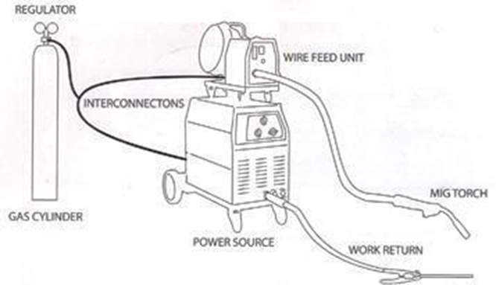
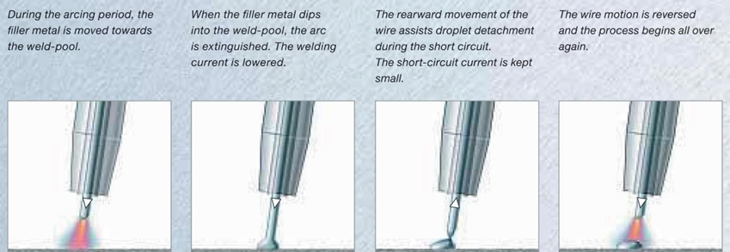
Cold metal transfer (CMT) process is a highly developed version of Metal Inert Gas/ Metal Arc Gas (MIG/MAG) arc welding process with a precise process control and low heat input to the base material.
it uses a pulsing action instead of a continuous stream of power, CMT welding generates only one-tenth of the heat that MIG welding does. This reduction in heat is CMT’s greatest benefit and is why it’s called “Cold” metal transfer.

Slide 8
SS304 CHARACTERISTICS
Alloy 304 is a chromium-nickel molybdenum austenitic stainless steel developed to provide improved corrosion resistance to Alloy 304 in moderately corrosive environments.
Alloy 304 resists atmospheric corrosion, as well as, moderately oxidizing and reducing environments. It also resists corrosion in polluted marine atmospheres.
Alloy 304 is non-magnetic in the annealed condition, but can become slightly magnetic as a result of cold working or welding. It can be easily welded and processed by standard shop fabrication practices.
Alloy 304 performs well in sulphur containing service such as that encountered in the pulp and paper industry. The alloy can be used in high concentrations at temperatures up to 120°F (38°C).
Alloy 304 can be readily welded by most standard processes.
A post weld heat treatment is not necessary.

Slide 9
CHEMICAL COMPOSITION OF SS304
Element | Minimum (%) | Maximum (%)
Carbon (C) | - | 0.03
Manganese (Mn) | - | 2
Phosphorus (P) | - | 0.045
Sulfur (S) | - | 0.03
Silicon (Si) | - | 1
Chromium (Cr) | 18 | 20
Nickel (Ni) | 10 | 14
Molybdenum (Mo) | 2 | 3
Nitrogen (N) | - | 0.1
Iron (Fe) | Balance | Balance

Slide 10
STAINLESS STEEL ALLOY (SS304)
SS304 stainless steel is a kind of Austenitic stainless steel, a lower carbon variant of 304 stainless steel. Both 304 and 316 stainless steels contain molybdenum, but 316L stainless contain more molybdenum than 304 stainless steel. Due to the addition of molybdenum in the steel, the overall performance of 304 steel is superior to that of 310 and 316 stainless steel.
SS304 stainless steel has a maximum carbon content of 0.03 amd can be used in applications where post-welding annealing is not possible and where maximum corrosion resistance is required. Since 304 stainless steel features better carbide precipitation resistance than 304 stainless steel, 304 can be continuously exposed to the temperature of 427˚C – 857˚C (800˚F - 1575˚F), where 304 is not advisable to.
Though 304 features better corrosion resistance than 316, but its mechanical properties are not as good as 304.

Slide 11
WELDING PROCESS OF (SS304)
SS304 were used as a base metal. Base metals were machined to rectangular samples with the following dimensions: 60mm x 100mm x 3mm
Prepare the materials: Ensure that the two pieces of plates are clean and free from any rust, dirt, or other contaminants. Bevel the edges of the plates to create a V-groove, which will help to ensure proper penetration of the weld.
Set up the welding equipment: Set up the CMT welding equipment according to the manufacturer's instructions, including selecting the appropriate wire size, shielding gas, and welding parameters such as voltage, current, and wire feed speed.
Position the plates: Position the two plates so that the edges to be welded are aligned and held securely in place. You can use clamps or fixtures to hold the plates in position.

Slide 12
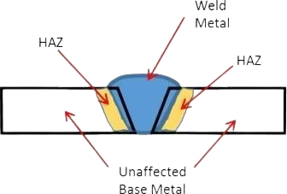
Start the welding process: Begin the CMT welding process by initiating the arc and feeding the filler material intermittently using the CMT welding torch. Move the torch along the V-groove while maintaining a consistent distance between the torch and the workpiece.
Continue welding: Continue welding along the length of the joint until the entire joint is completed. Be sure to maintain proper penetration and control of the heat input to avoid overheating or burning through the thin material.
Finish the weld: Once the welding is complete, allow the joint to cool down slowly to prevent any distortion or warping. Remove any excess slag or spatter, and inspect the weld for defects such as cracks or incomplete penetration.

Slide 13
304 stainless steel has a maximum carbon content of 0.03 and can be used in applications where post-welding annealing is not possible and where maximum corrosion resistance is required. Since 304 stainless steel features better carbide precipitation resistance than 304 stainless steel, 304 can be continuously exposed to the temperature of 427˚C – 857˚C (800˚F - 1575˚F),
S.No | Current (A) | Voltage (V) | Gas Flow Rate (Lit/min) | Welding speed (mm/sec) | Wire feed rate (m/min)
1. | 130 | 12.7 | 11 | 150 | 5.3
2. | 140 | 17.3 | 12 | 200 | 3.5
3. | 150 | 12.7 | 13 | 250 | 5.3
4. | 160 | 14.6 | 14 | 300 | 5.8

Slide 14
COMPOSITION OF SS304
.
Element | C | Mn | P | S | Si | Cr | Ni | Mo | N | Fe
SS304 | ≤ 0.03 | ≤ 2 | ≤ 0.045 | ≤ 0.03 | ≤ 1 | 18- 20 | 10- 14 | 2-3 | ≤ 0.1 | Balance
MECHANICAL PROPERTIES OF SS304
Grades | Tensile Strength Ksi (Mpa), min | Yield Strength, ksi (Mpa) | Elongation, % | Hardness, Rockwell
SS304 | 75(515) | 30(205) | 40 | B82

Slide 15
INVESTIGATION
Tensile Test
A tensile test, also known as a tension test, is a common method used to determine the mechanical properties of materials, such as their strength, ductility, and elasticity. The test involves subjecting a specimen to a gradually increasing tensile force until it fractures, while measuring the changes in the specimen's dimensions and load response.
Impact Test
An impact test is a mechanical test used to evaluate the ability of a material to withstand sudden, high-stress loading conditions, such as those that may occur during an impact or collision. The test involves striking a specimen with a pendulum or other impact device, and measuring the energy absorbed by the specimen and the resulting deformation or fracture behavior.

Slide 16
TENSILE TEST
Tensile Testing is a form of tension testing and is a destructive engineering and materials science test whereby controlled tension is applied to a sample until it fully fails.
Tensile test was carried out on the similar weldments using Universal Testing Machine (UTM) obtained from the CMT welding techniques employing ERNiCr-3
Ex no | Gauge Width (mm) | Gauge Thickness (mm) | Original cross section (mm ̂ 2) | Ultimate Tensile Load(kN) | Ultimate Tensile Strength (N/mm ̂ 2 or Mpa)
1 | 5.94 | 2.93 | 17.40 | 7.81 | 488
2 | 5.93 | 2.94 | 17.43 | 5.62 | 400
3 | 5.95 | 2.92 | 17.37 | 5.16 | 390
4 | 5.95 | 2.93 | 17.43 | 12.01 | 560

Slide 17
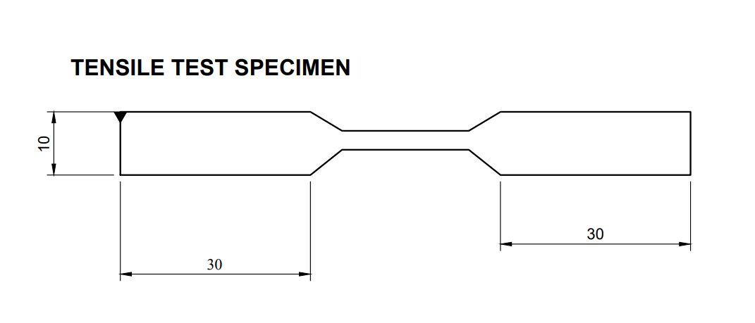

Slide 18
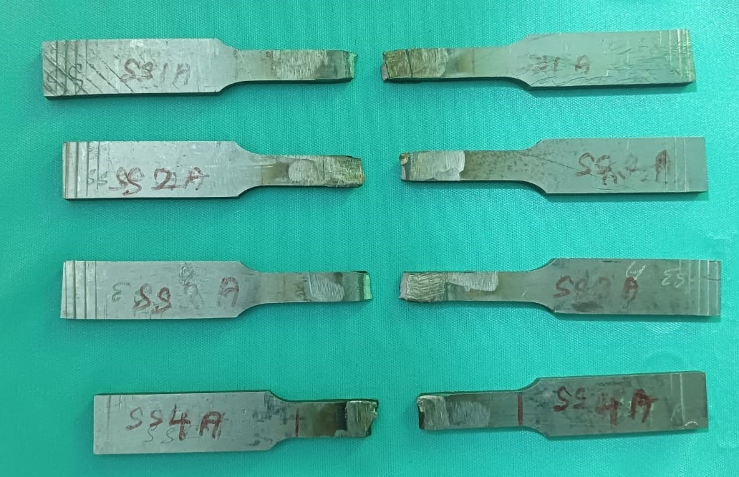

Slide 19
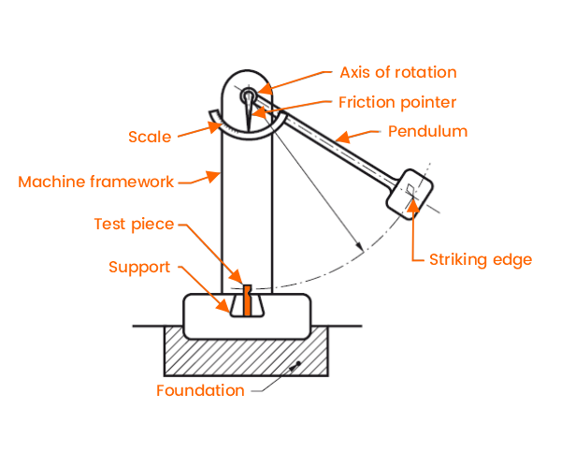
IMPACT TEST
Impact test, test of the ability of a material to withstand impact, used by engineers to predict its behaviour under actual condition. Many materials fail suddenly under impact under impact, at flaws, cracks, or notches.
The purpose of an impact test is to determine the ability of the material to absorb energy during a collision.
TEST TRAIL NO | IMPACT KJ
1 | 120
2 | 180
3 | 220
4 | 150

Slide 20
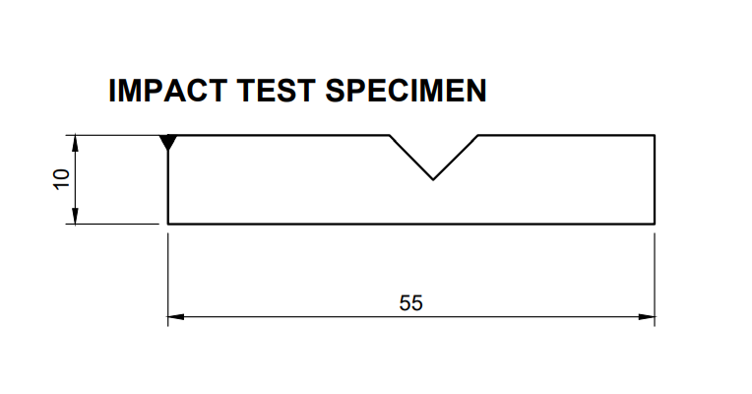

Slide 21
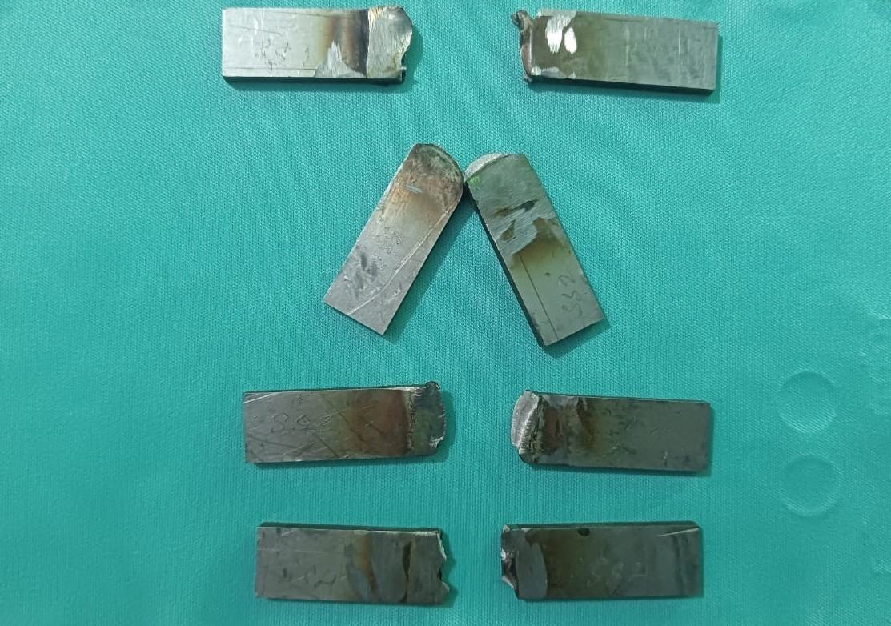

Slide 22
CONCLUSION
This study investigates the tensile strength and Impact strength characterization of the similar metal welding of stainless steel, SS304, obtained by CMT welding with 316L fillers.
The results of the study can be summarized as follows:
Successful weldment obtained for all specimens in terms of macrostructure, without any lack of penetration, crack, spatter, etc.
Tensile tests were carried out with respect to variation of gas flow rate, current and welding speed.
The graph between load vs displacement were obtained respectively.
The Experiment with parameter as current 120 A, welding speed 200 mm/min and gas flow rate 12 lpm has the maximum tensile strensth of 689 MPa by withstanding a load of 12.01 kN
And the minimum tensile strength was obtained with experiment parameter as current 100 A, welding speed 300 mm/min, and gas flow rate 13 lpm with 297 MPa tensile strength by withstanding 5.16 kN
The results of the study will be very useful for the Original Equipment

Slide 23
COST ESTIMATION
Process | Cost | Total
Material Cost/ Preparation | ₹4000 | ₹ 4000
Welding Charge | ₹400*4 | ₹ 1600
Wire cut EDM | ₹8000/hr (40mins) | ₹ 5300
Tensile Test | ₹400*4 | ₹ 1600
Impact Test | ₹300*4 | ₹ 1200
Total Cost |  | ₹ 13,700

Slide 24
REFERENCES
Hongyan Gao, Wei Ke, Yue Zhao, et al., ‘Investigation on Microstructure and Mechanical Properties of CMT Welded similar Joint of Austenitic Stainless Steel and Low Alloy Steel’, Materials Science Forum, 2021, vol. 1045, pp. 301-307.
M. Jiang, W. Gao, X. Lu, et al., ‘Microstructure and Mechanical Properties of CMT Welded similar Joints between Austenitic Stainless Steel and Low Alloy Steel’, Journal of Materials Engineering and Performance, 2021, vol. 30, pp. 1668-1678.
S. K. Singh, S. Das, A. K. Singh, et al., ‘Microstructural characterization and mechanical properties of cold metal transfer welded 304 austenitic stainless steel’, Journal of Materials Research and Technology, 2021, vol. 12, pp. 1566-1580.
Y. Sun, L. Wang, X. Wang, et al., ‘Effects of Welding Parameters on Microstructure and Mechanical Properties of CMT Welded Austenitic Stainless Steel’, Journal of Materials Science

Slide 25
THANK YOU

